Slide 1
Proposal Submission &
Review Procedures
A Handbook for RGCB Investigators
Version 01 Date: February 25,2020

Slide 2
Purpose of the Document
A quick reference handbook to support RGCB Investigators towards effective project submissions for consideration by the RGCB IHEC committee review.

Slide 3
Overview of the Contents
Scope
Composition of EC
Regulatory body & References
IHEC Office details
Ethics Committee Timelines
Types of Applications
Application packages
Submission procedures
Handling of Applications
Decision process
Overall timeline chart

Slide 4
Scope
Submission of the research proposal for initial review.
Resubmission of research proposal with corrections and amendments.
Submission of approved protocols for continuing review.
Submission of the study completion reports.
Submission for any special requests on previously approved proposals.

Slide 5
Composition of EC
Sl No | Name | Role in IHEC
1 | Dr. M. Narendranathan | Chairperson
2 | Prof. V. Ramankutty | Vice Chairperson /Clinician
3 | Prof. H. V. Easwer | Clinician
4 | Dr. S. Sankar | Medical Scientist
5 | Dr. Bushra Beegom | Social Scientist
8 | Advocate Benoy T George | Legal expert
9 | Ms. Tigi Philip | Lay person
10 | Dr. Devasena Anantharaman | Member Secretary
11 | Dr. Abdul Jaleel | Alternate Member Secretary/ Basic Scientist
12 | Dr. Priya Srinivas | Basic Scientist
13 | Dr. Rakesh Laishram | Basic Scientist

Slide 6
Regulatory Body
Drugs Controller General of India : https://cdsco.gov.in/opencms/opencms/en/Home/
Department of Health Research: https://dhr.gov.in/
References
ICMR 2017 Guidelines
https://www.icmr.nic.in/sites/default/files/guidelines/ICMR_Ethical_Guidelines_2017.pdf
FERCI SOP: http://ferci.org/

Slide 7
Contact Details
Institutional Human Ethics Committee Office
Fourth floor, Next to HPV Lab
RGCB Main Campus
Extension No: 448
Timing : 9am to 5.30pm
Member Secretary: Dr. Devasena Anantharaman
Secretariat: Divya Jayalekshmy

Slide 8
Ethics Committee Timelines
Sl No | Description | Timeline | Notes
1 | Submission of proposals | Year Around | All proposals will be accepted at the IHEC office in the fourth floor
2 | EC meeting schedule Full committee review Expedited committee review Exemption review | Every three months Every month Continuous | IHEC full committee review meeting will be held on 4th week of every three months
3 | Decision making communication | within 14 days after the EC meeting | PI has to respond to the EC queries within 14 days of receipt of the letter of comments.

Slide 9
Type of Applications
Sl No | Type of applications | Category to apply
1 | New proposals/initial review | All the research proposals involving human subjects has to undergo IHEC approval
2 | Resubmission of the proposals with major/minor amendments | All the research proposals which requires significant/minor modifications after the initial full committee review
3 | Progress report | All the ongoing research proposals has to be reviewed once a year to evaluate the progress of the study
4 | Completion of the study | After the completion of the study, final report has to be submitted by the PI’s for reviewing.
5 | Amendment request | Any major/minor changes(title change or collaborator change or protocol change or change in ICD) in the previously approved study has to be resubmitted with supporting documents.

Slide 10
Application packages
Mandatory documents
Covering letter to the Chairperson
Project submission application form duly filled
Research protocol summary
Duty delegation log of the study team
Informed consent document (ICD) in English and in local language
Sanction letter from the head of the institution
Brief curriculum vitae of all the study members

Slide 11
Continued…
Supporting documents (if applicable)
Ethical committee clearance letter from collaborating centers
Informed consent waiver form
MOU from the collaborating centers
Institutional stem cell research committee approval

Slide 12
Application Packages
Type of Applications | Mandatory documents | Supporting documents
Resubmission proposals | Covering letter to the Member Secretary/ Chairperson | List of point wise reply to the RGCB IHEC letter of comments. Revised version of protocol, ICD, PIS, case report forms etc with changes made to the documents highlighted
Progress report |  | Continuing review application form duly filled
Completion report |  | In case of multi centric studies, site specific final report to be submitted
Amendment requests |  | Amendment request application form duly filled with supporting documents

Slide 13
Submission Procedure
To be submitted year around or 30 days prior to the EC meeting
Submit 1 hard copy of the research proposal at EC office &
1 soft copy to ihec@rgcb.res.in
Verification of the submission package at the IHEC office
Assigning IHEC protocol ID

Slide 14
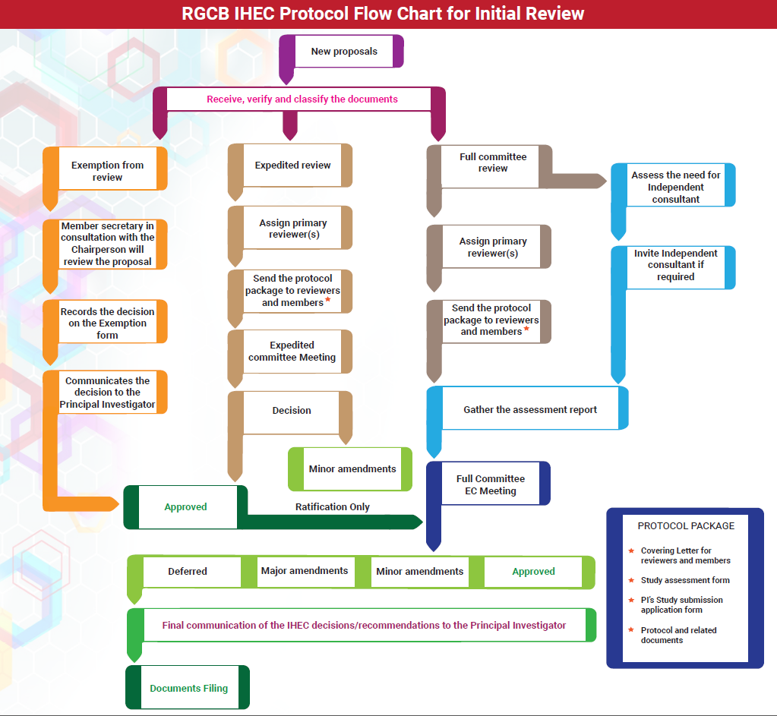
Handling of Applications

Slide 15
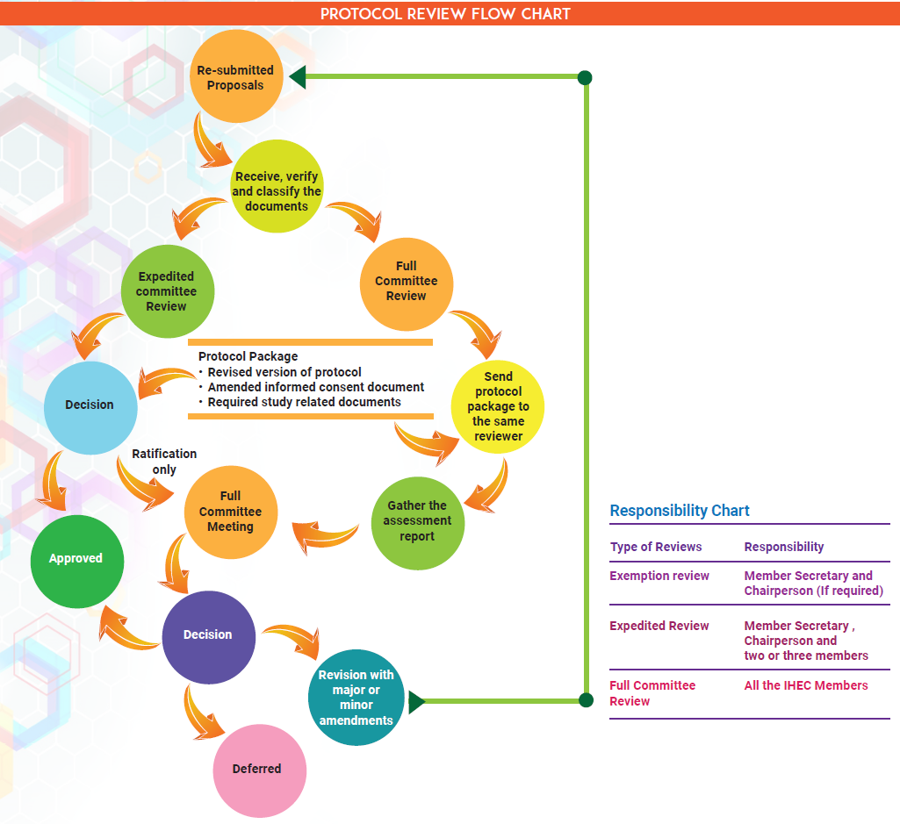
Handling of Applications

Slide 16
Handling of Applications
Progress report
Completion report
Amendment requests
Full committee/ expedited review
Decision
Modifications recommended
Accepted
Additional information required

Slide 17
Decision Process
Decision Types | Resubmission | Timeline
Approved | - | -
Major Amendments | Resubmission at Full committee review | Within 30 days of notification
Minor Amendments | Resubmission at Expedited committee | Within 14days of notification
Deferred | Resubmission at Full committee Review | Within 6 weeks of notification

Slide 18
Decision Process
Decision will be notified to the Investigators by email within 14 working days after the meeting.
In case of non response to reminders sent by the secretariat within 30 days of receipt of decision letter, the matter will be addressed at the forthcoming full committee meeting.

